Slide 1
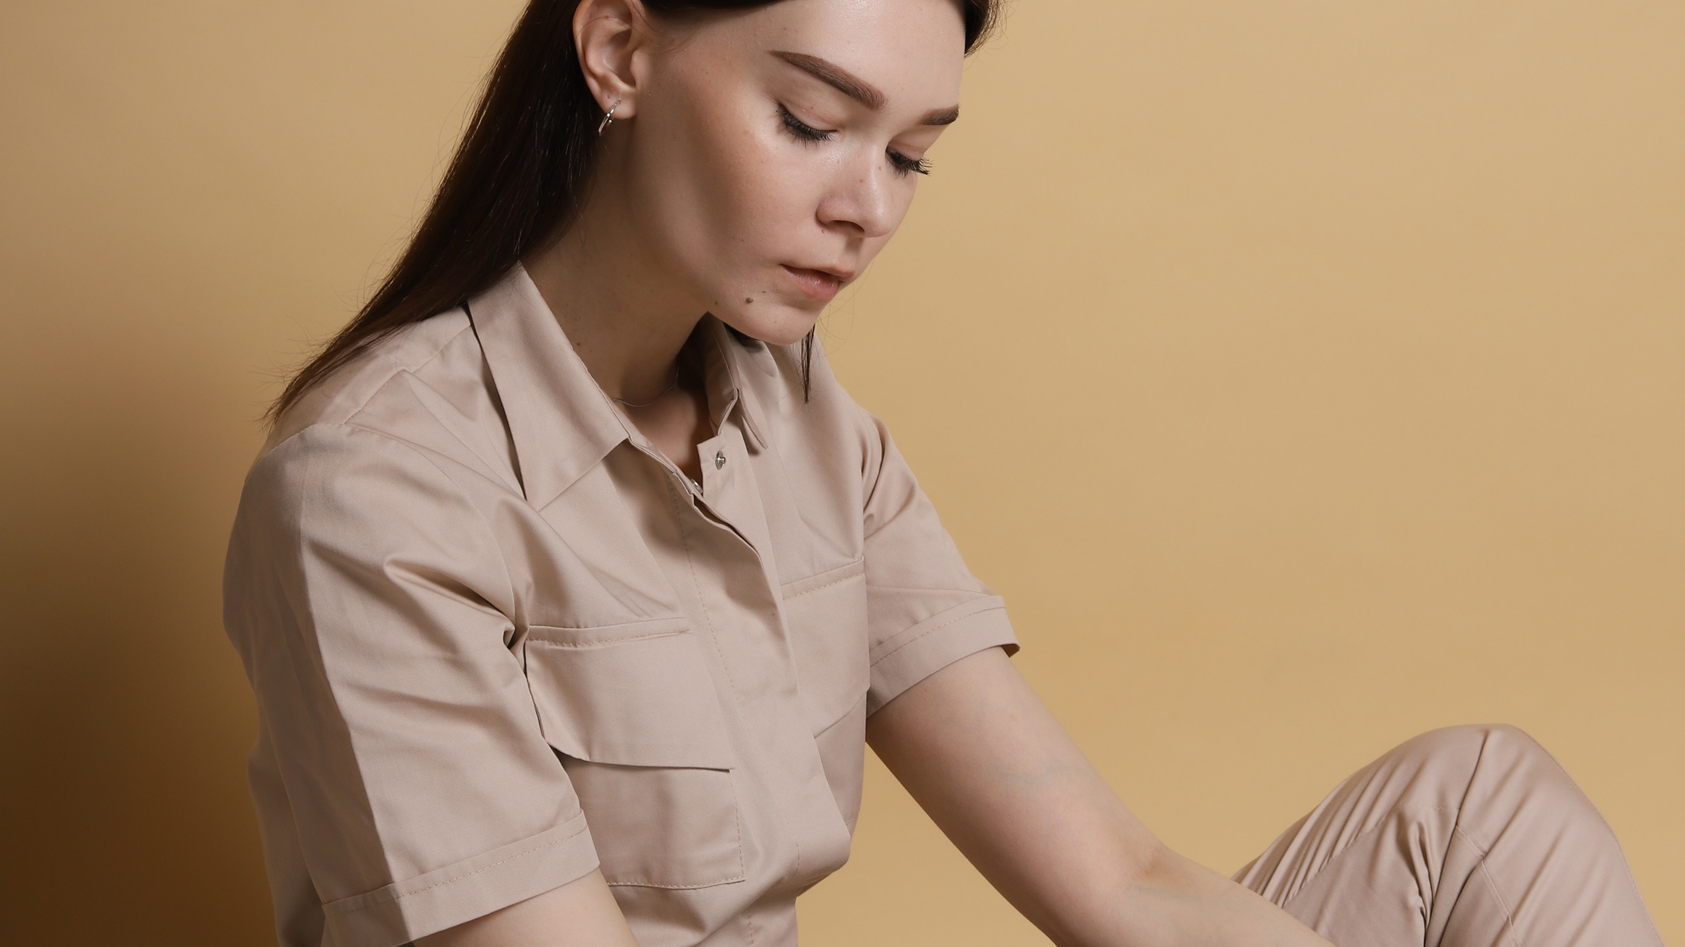

FINAL PITCH
HiraI

Slide 2
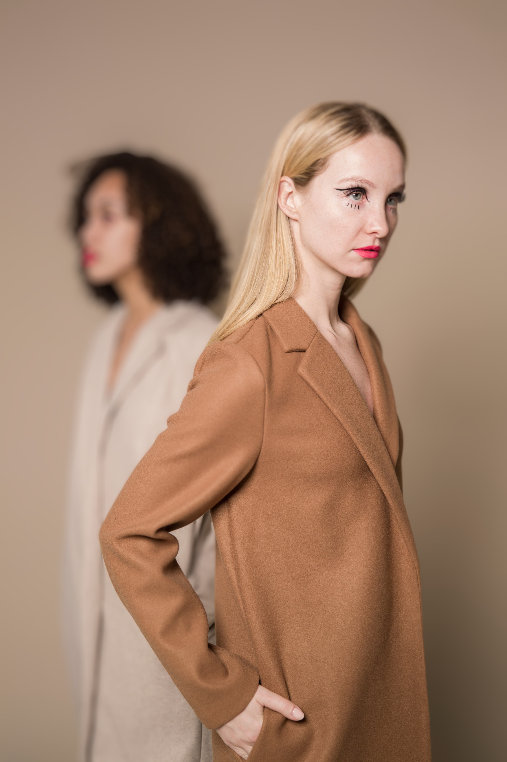
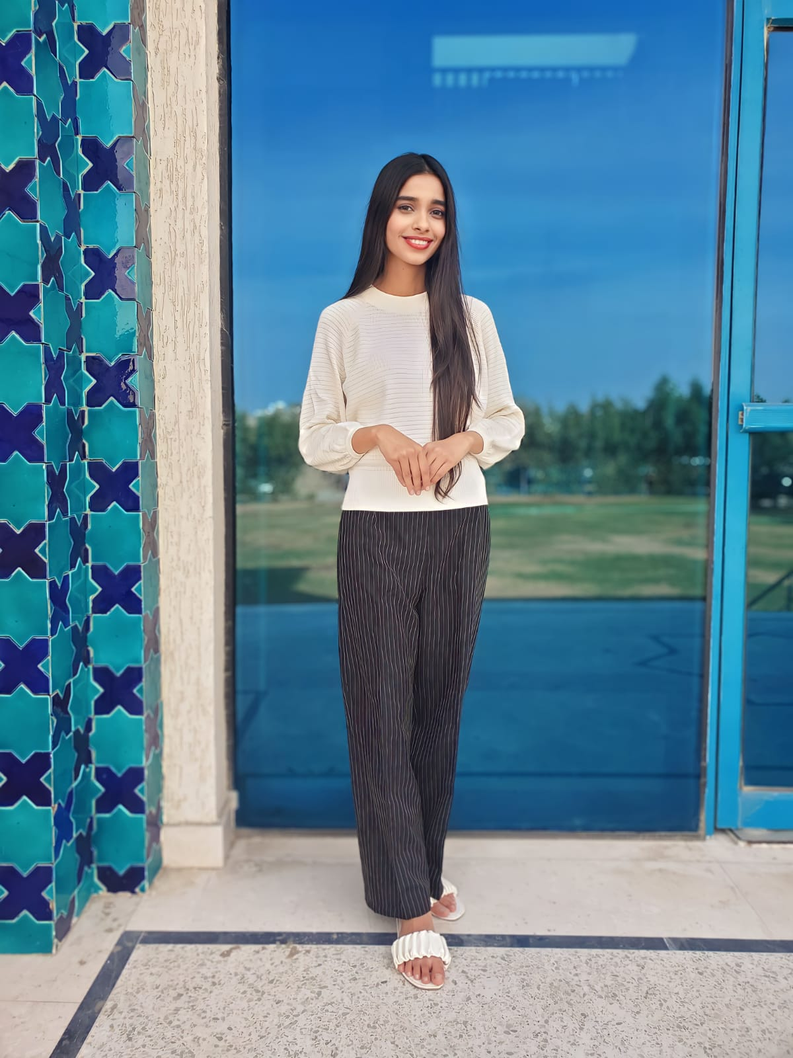
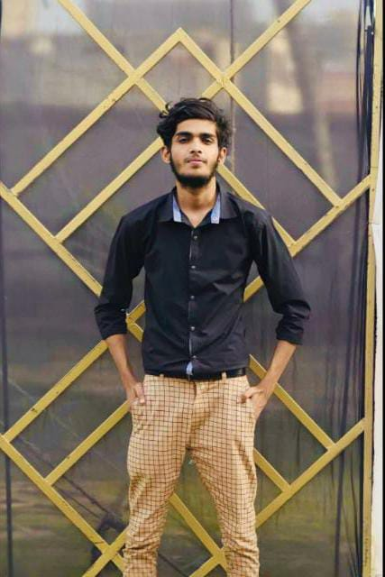
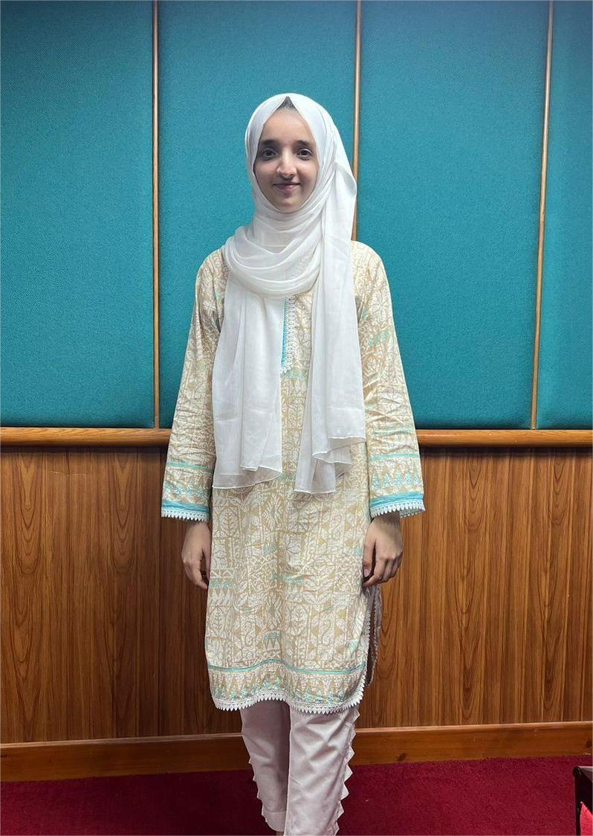
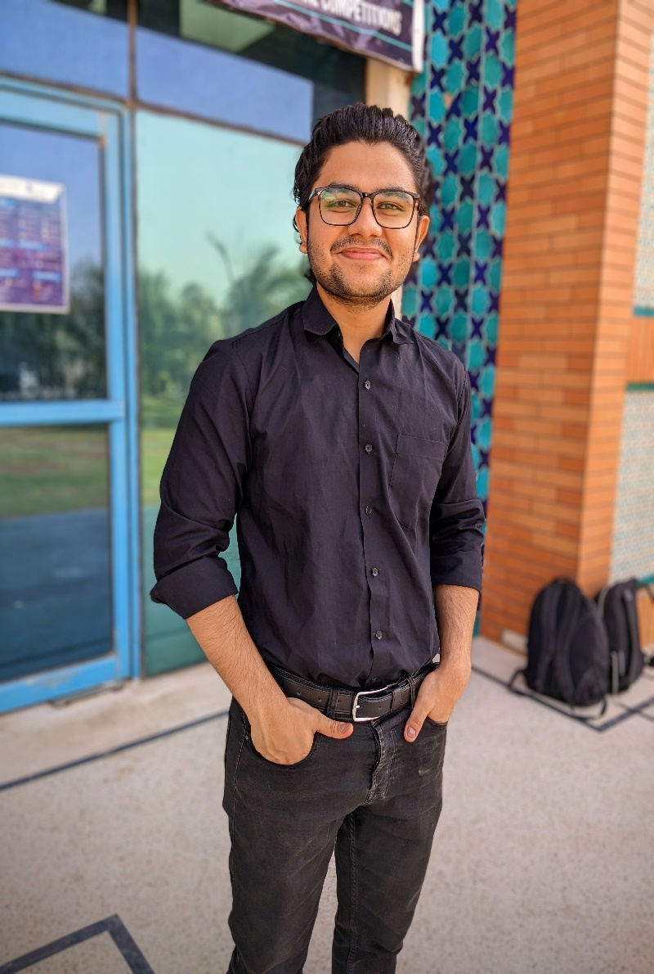
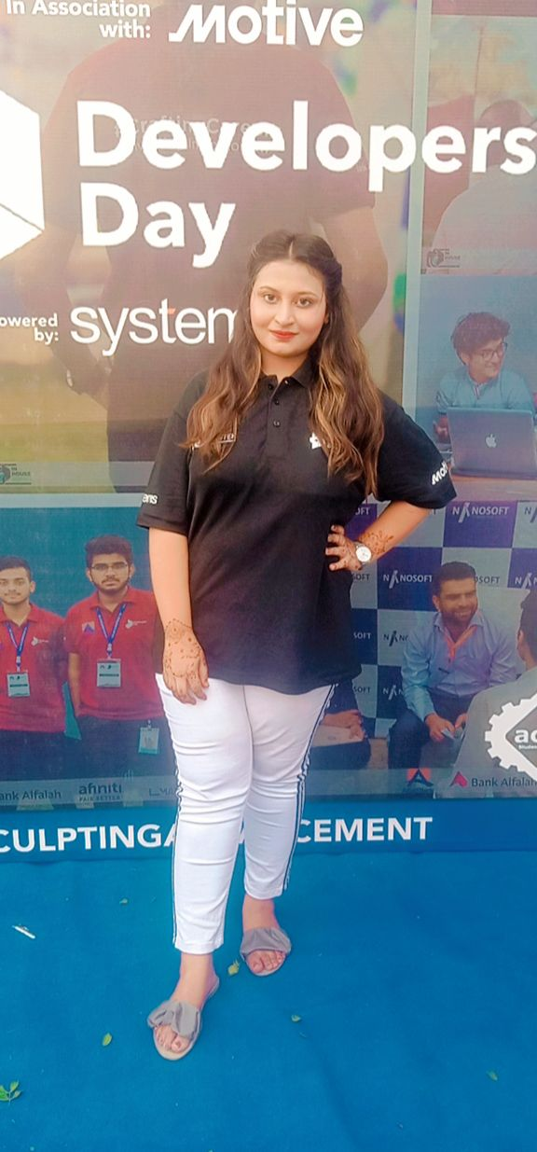
Agency Members
Insha Samnani (20K-0247)
Ismail Ansari (20K-0228)
Yusra Adam (20K-0207)
Ali Nadir (20K-0325)
Anjiya Ali (20K-1687)

Slide 3
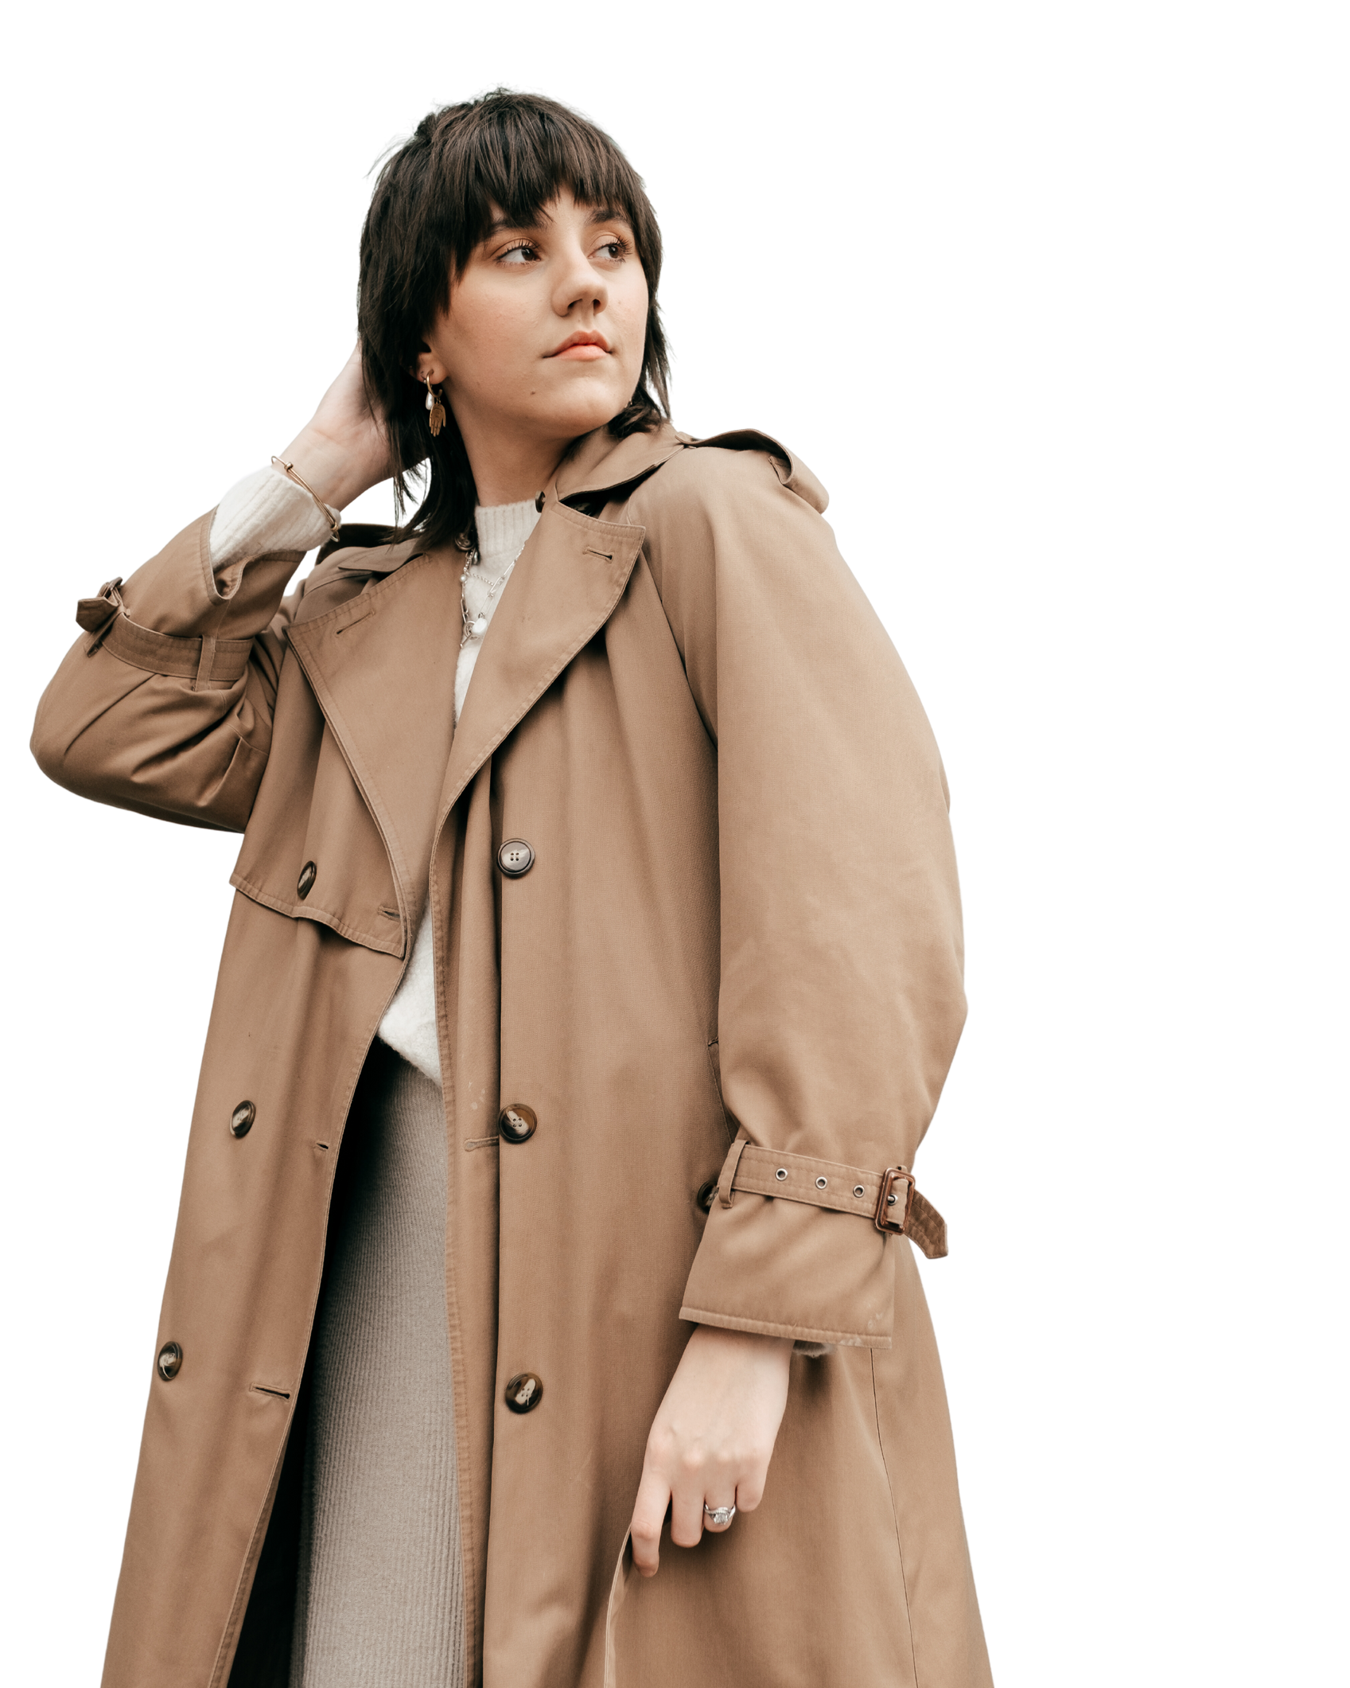
TABLE OF CONTENTS
01
02
02
NAME OF THE CLIENT AND THE PRODUCT OUR CAMPAIGN IS ABOUT.
03
ADVERTISING CAMPAIGN OBJECTIVE
04
DESCRIPTION OF PRIMARY AND SECONDARY TARGET MARKETS
05
PRINT AD
06
PROMOTIONAL VIDEO - REASON TO CREATE IT
07
SOCIAL MEDIA AD - REASON TO CHOOSE META
08
RADIO AD - WHAT WE ARE TRYING TO COMMUNICATE
RADIO AD – 3 CHOOSEN LOCAL STATIONS

Slide 4
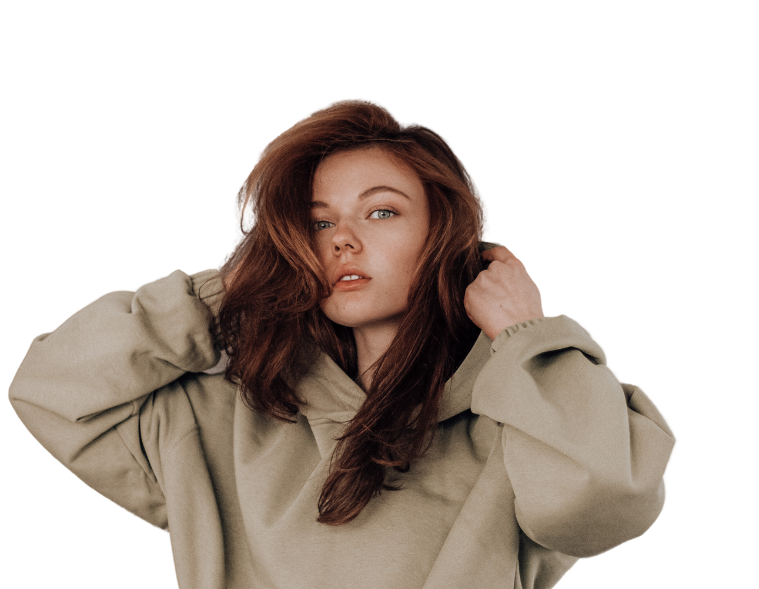
EVERGREEN
Through our brand EverGreen, we aim to offer not just garments, but confidence, style, and sustainability in every thread.
Notes:
Product and client name is same.

Slide 5
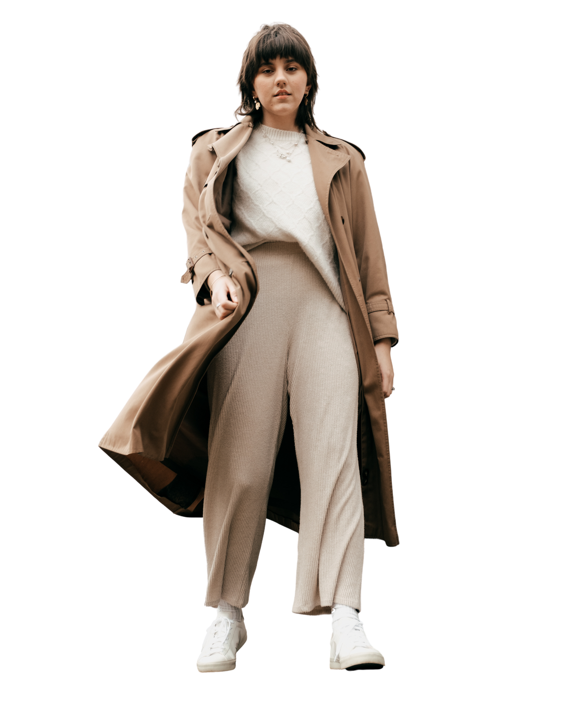
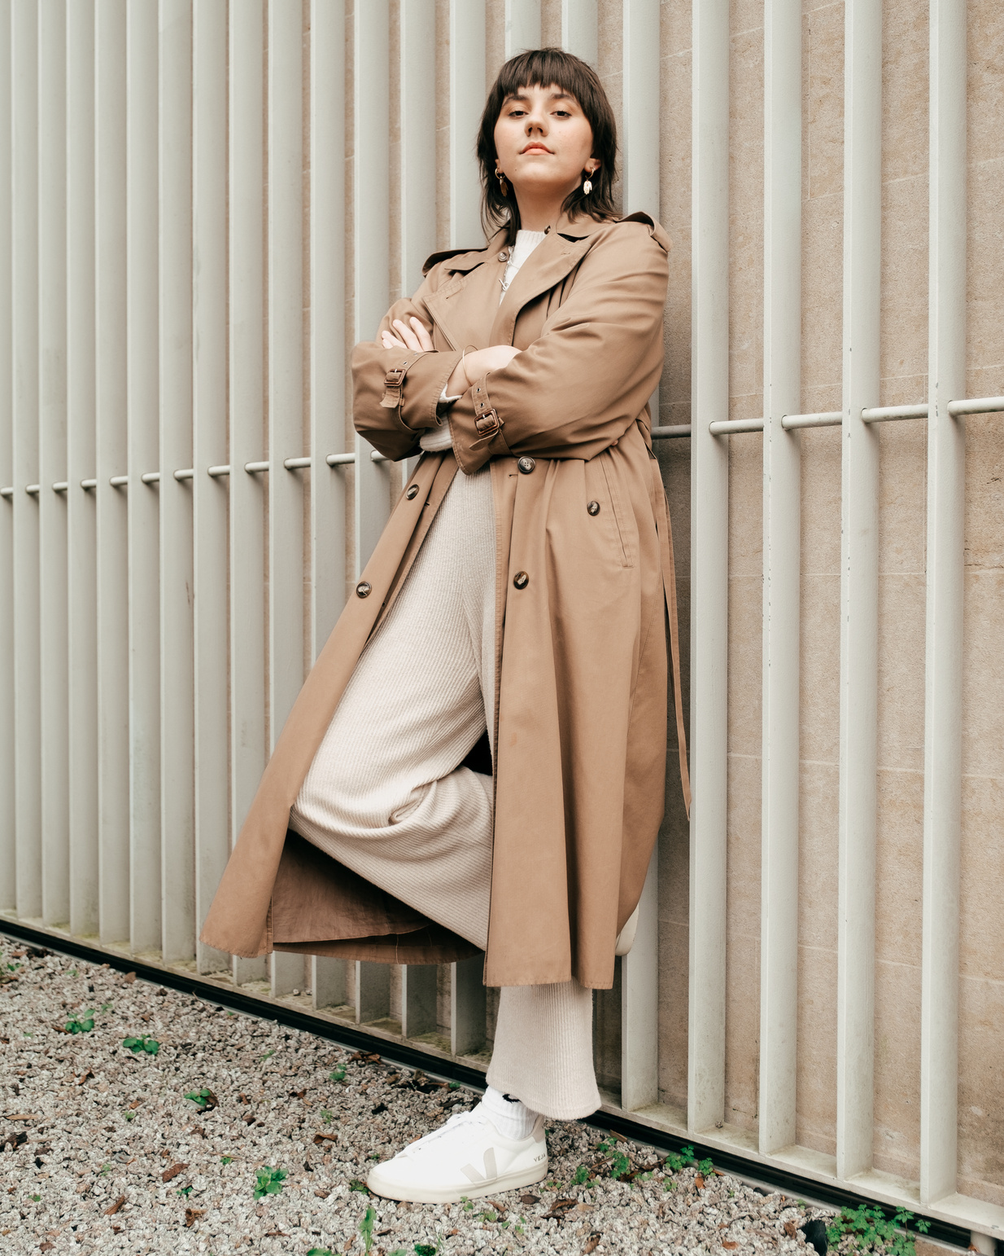
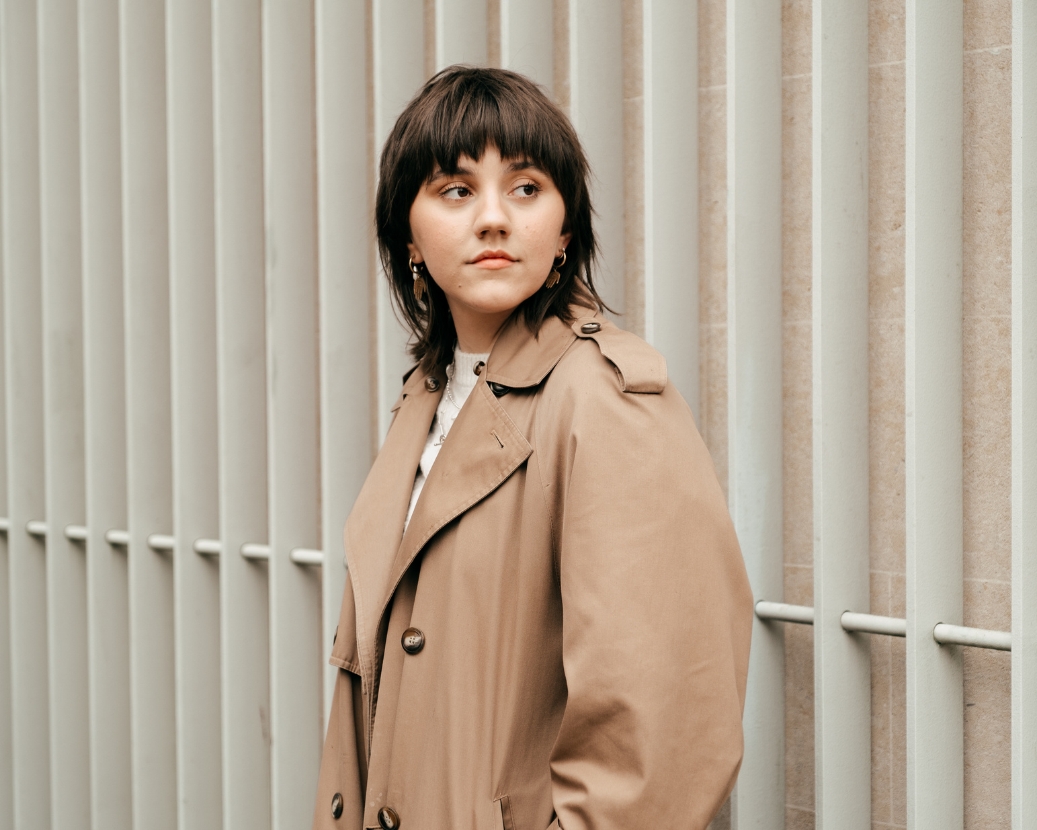
Advertising Campaign Objective
OBJECTIVE
Increase brand awareness and drive sales of EverGreen clothing by 20% within the next six months.
ROLE: BRAND OWNER
WHAT WE DO?
YEAR: 2024
Our mission is to revolutionize the way people perceive and experience everyday clothing.

Slide 6
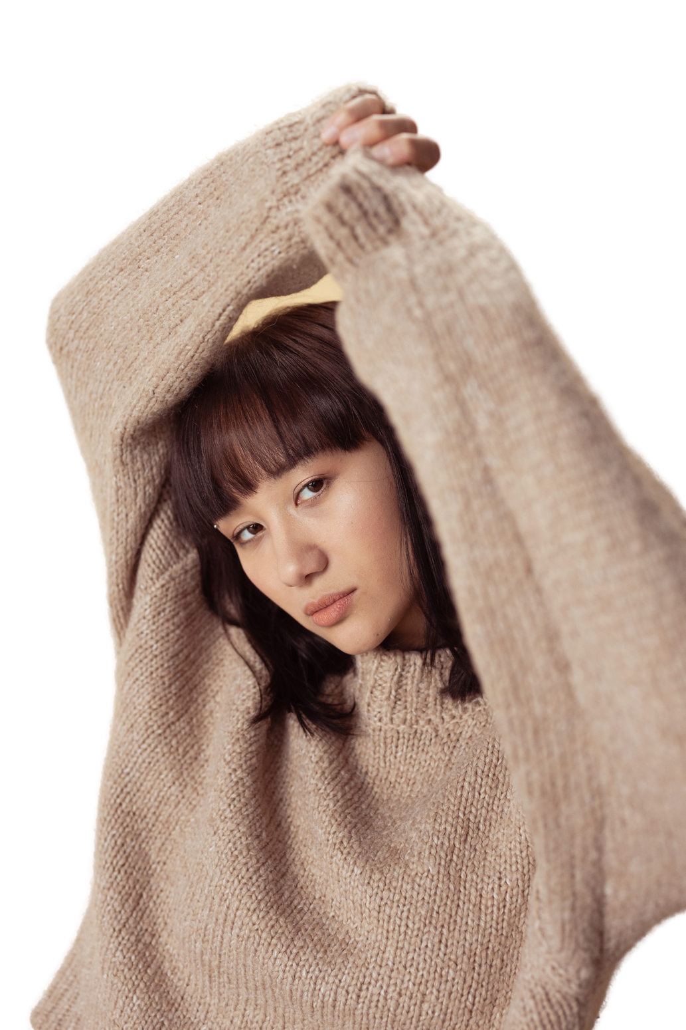
PRIMARY TARGET MARKETS
SECONDARY TARGET MARKETS
The primary target market for EverGreen clothing is teenagers and youth aged between 13 to 25 years old. This demographic is particularly attracted to fashionable clothing trends and values quality in their clothing choices. They seek garments that reflect their individuality and style while offering durability and longevity.
The secondary target market for EverGreen clothing encompasses all age groups and genders. It aims to appeal young adults, adults, and even older individuals, who appreciate high-quality clothing that transcends age and gender boundaries. By offering versatile and fashionable designs, EverGreen aims to cater to the diverse tastes and preferences of consumers across different demographics.
MARKETING SEGMENTATION
MARKETING SEGMENTATION
Demographic: Teenagers and youth aged 13-25, all genders
Psychographic: Fashion-conscious, value quality and versatility
Geographic: Urban and suburban areas with a high young population
Demographic: All age groups and genders
Psychographic: Quality and style prioritizers across demographics
Geographic: Nationwide coverage, urban and rural areas

Slide 7
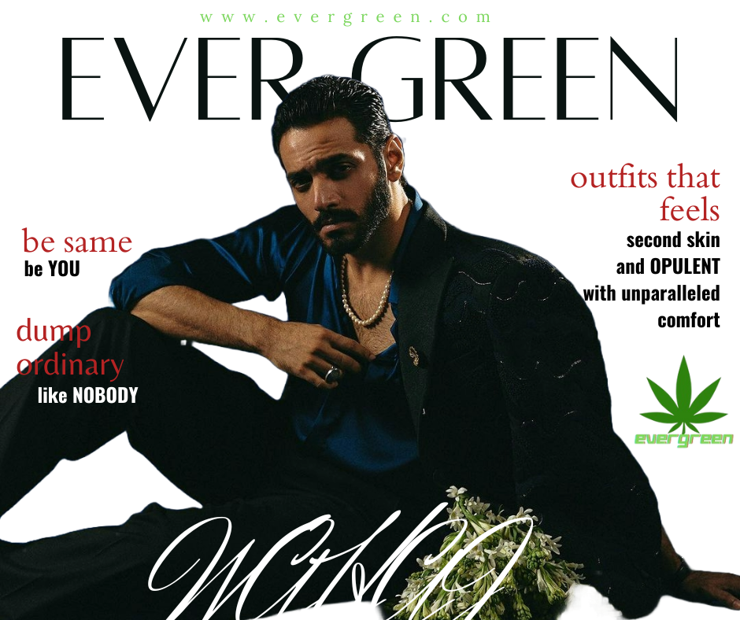
PRINT
AD

Slide 8
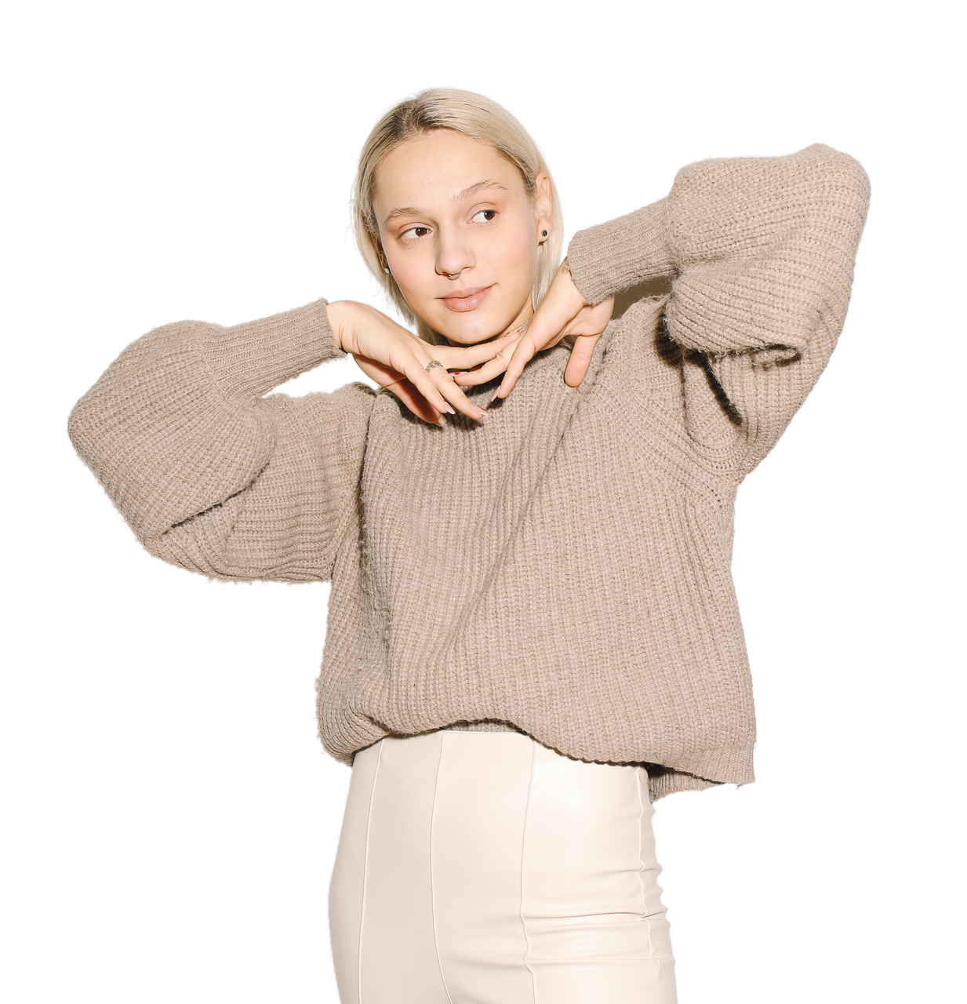
PROMOTIONAL VIDEO (Reason to use it?)
https://drive.google.com/file/d/1hTlhkjXwt0yBEBGlY4oYeT97kpnNZtUV/view?usp=drivesdk
1
2
3
4
VISUAL STORY TELLING
ENGAGING AUDIENCE
FLEXIBILE DISTRIBUTION
MAXIMIZING REACH
Utilizing dynamic visuals to showcase EverGreen clothing quality and versatility.
Capturing attention and fostering emotional connection through compelling narrative and music.
Ability to share across digital platforms like social media, websites, and email campaigns.
Leveraging video format to reach broader audience demographics and increase brand awareness.

Slide 9
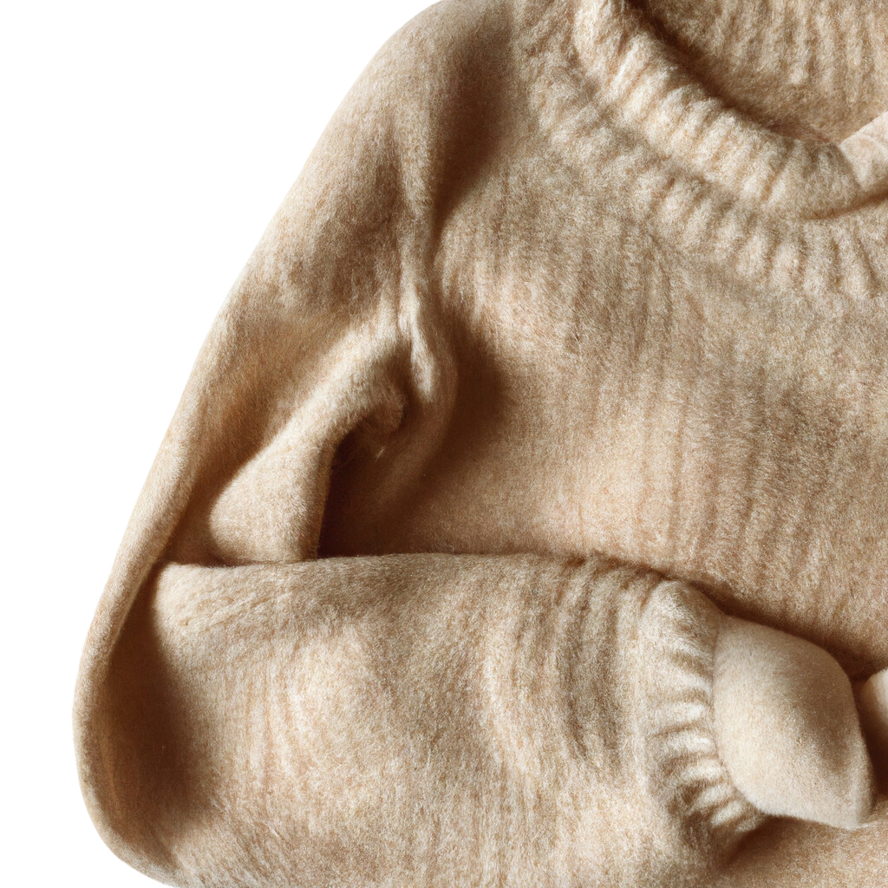
SOCIAL MEDIA AD
(Reason to choose META?)
1
EXTENSIVE REACH
META platforms collectively have billions of active users globally, offering a broad audience base for engagement.
2
VISUAL APPEAL
Instagram's visual-centric nature enables effective showcasing of EverGreen clothings' fashionability through photos and videos.
3
DIRECT COMMUNICATION
WhatsApp provides a direct and personal channel for one-on-one interactions with potential customers, fostering brand relationships.

Slide 10

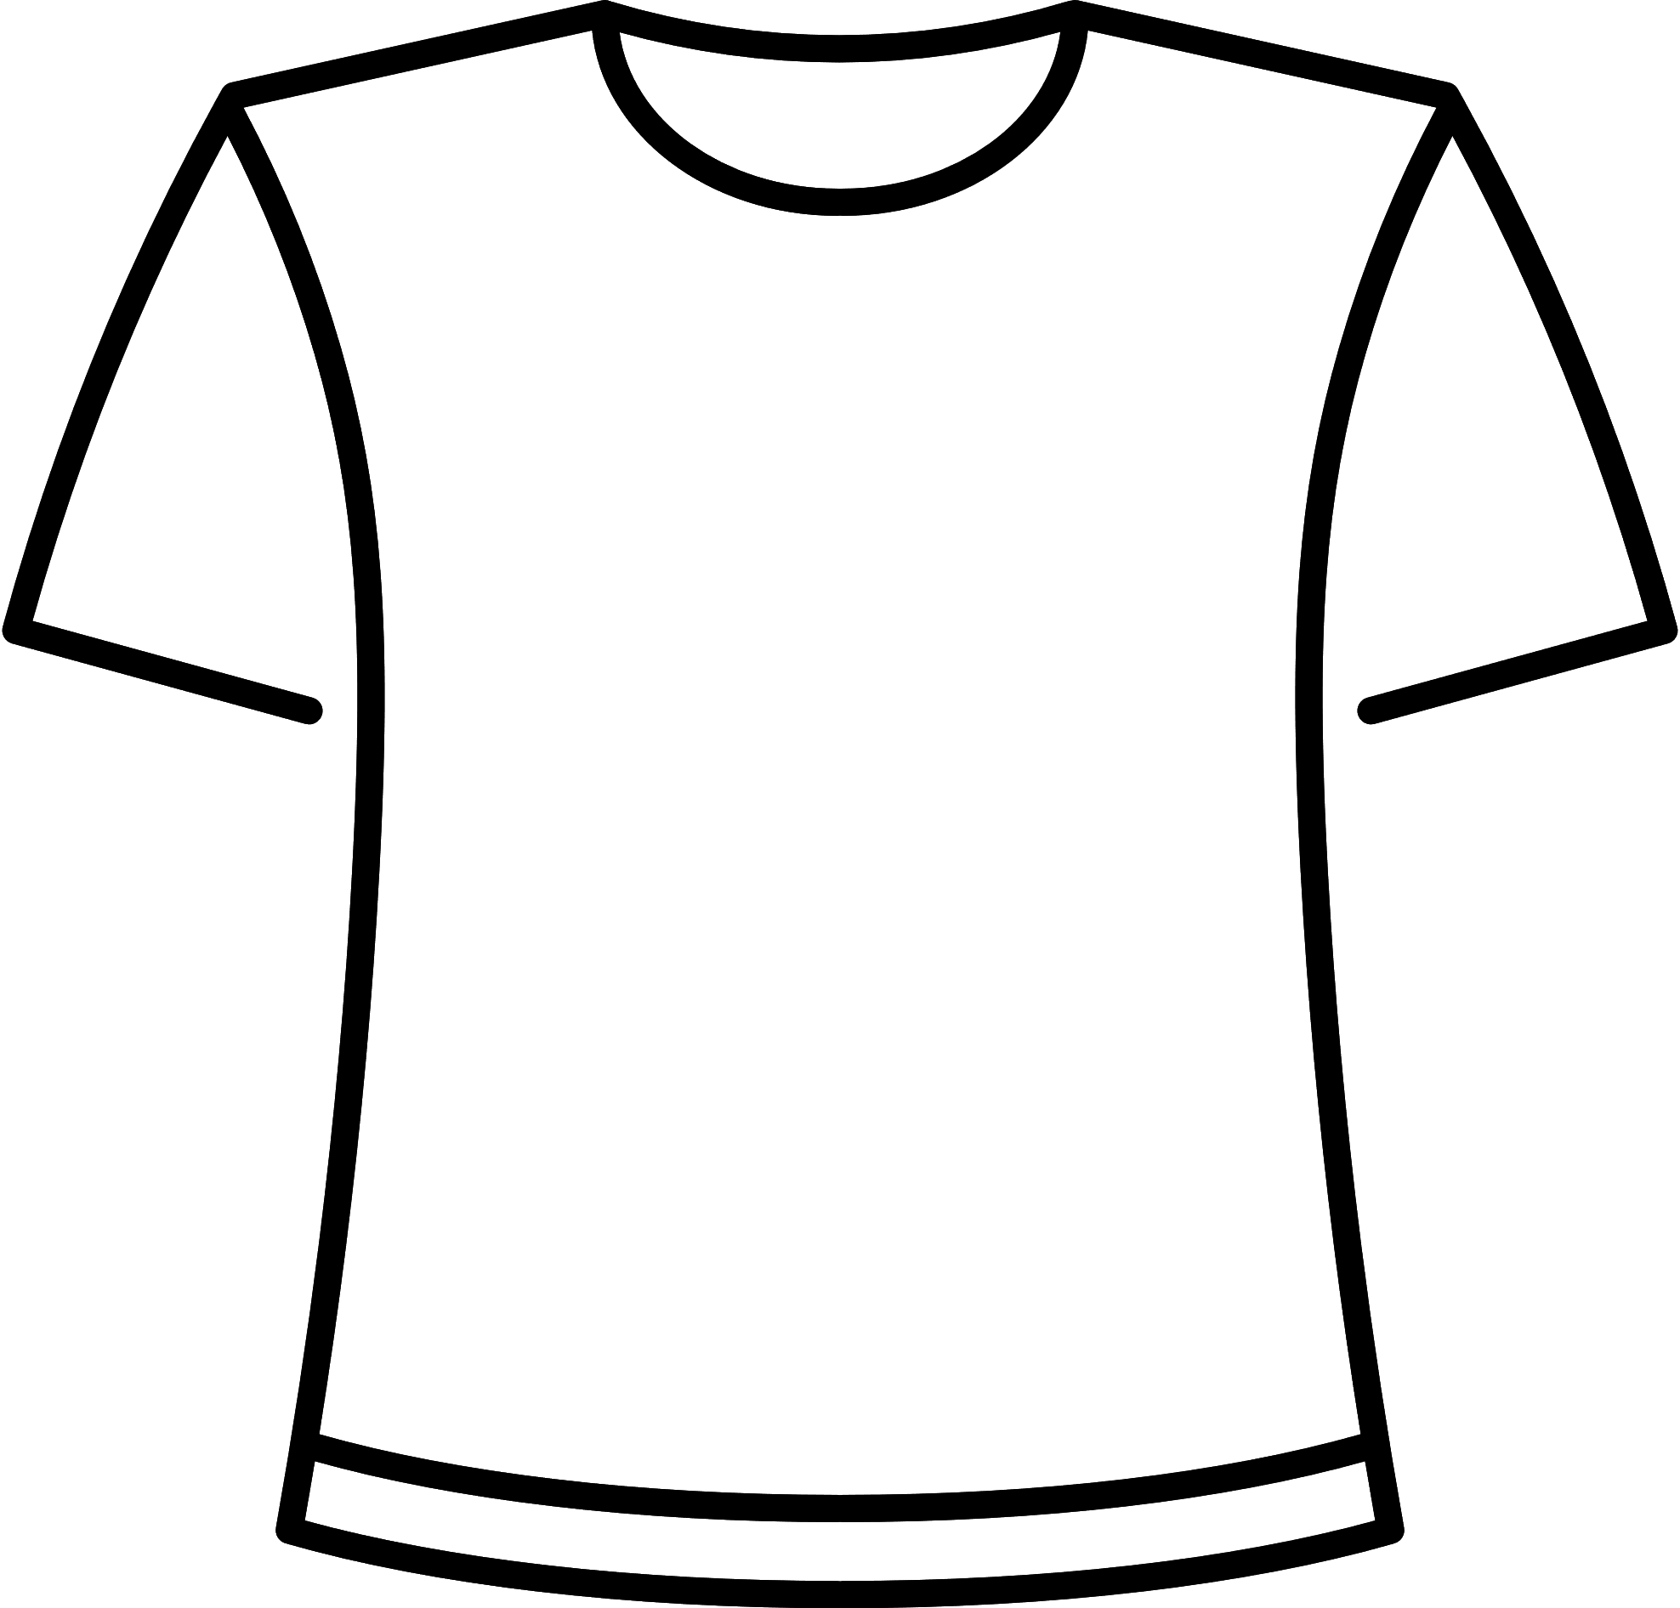
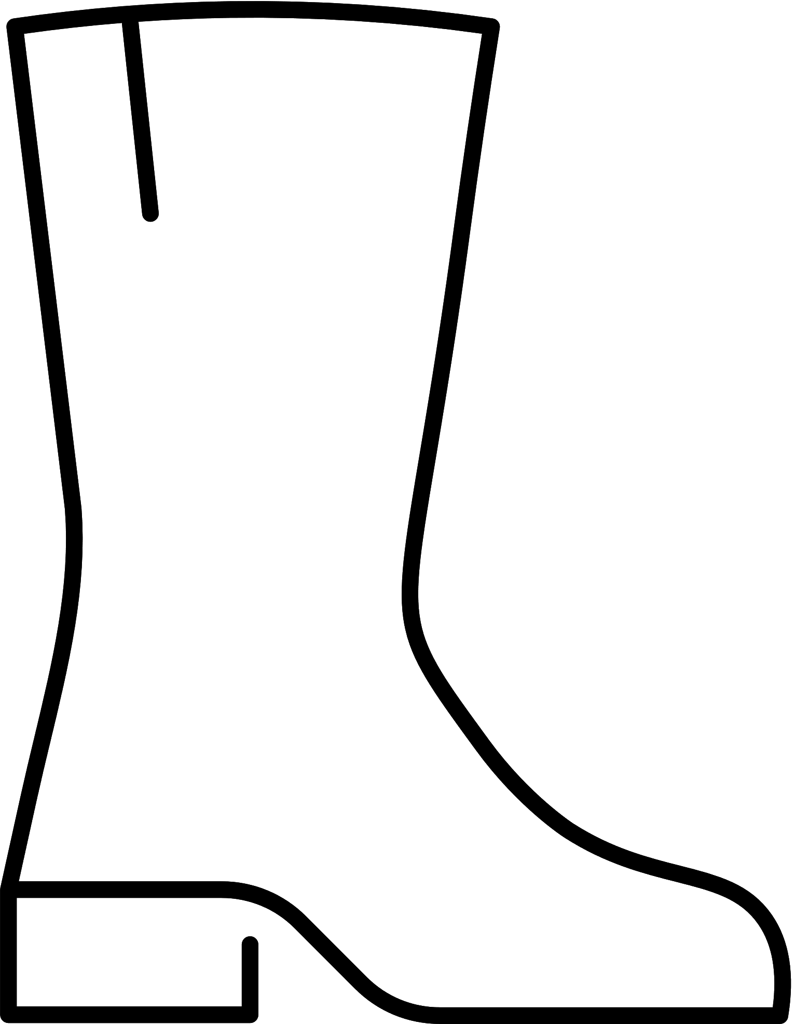

RADIO AD
(What were we trying to communicate?)
https://drive.google.com/file/d/1QxHCrmXhMlqQKJUy9ftvJvpxiWbC5qAg/view?usp=drivesdk
QUALITY ASSURANCE
FASIONABILITY
EverGreen clothing are synonymous with quality. We want to assure our listeners that they are investing in a product that is durable and made to last.
Our products are not just high-quality; they are also fashionable. We want to highlight the trendy designs and styles that EverGreen offers, appealing to the fashion-conscious nature of our target audience.
VERSATILITY
BRAND RECOGNITION
EverGreen clothing are versatile pieces that can be styled for various occasions, from casual outings to more formal events. We want to ensuring that they fit seamlessly into our listeners' lifestyles
By mentioning EverGreen in the ad, we aim to increase brand recognition among our target audience, making them more likely to consider our products when making their next clothing purchase.

Slide 11
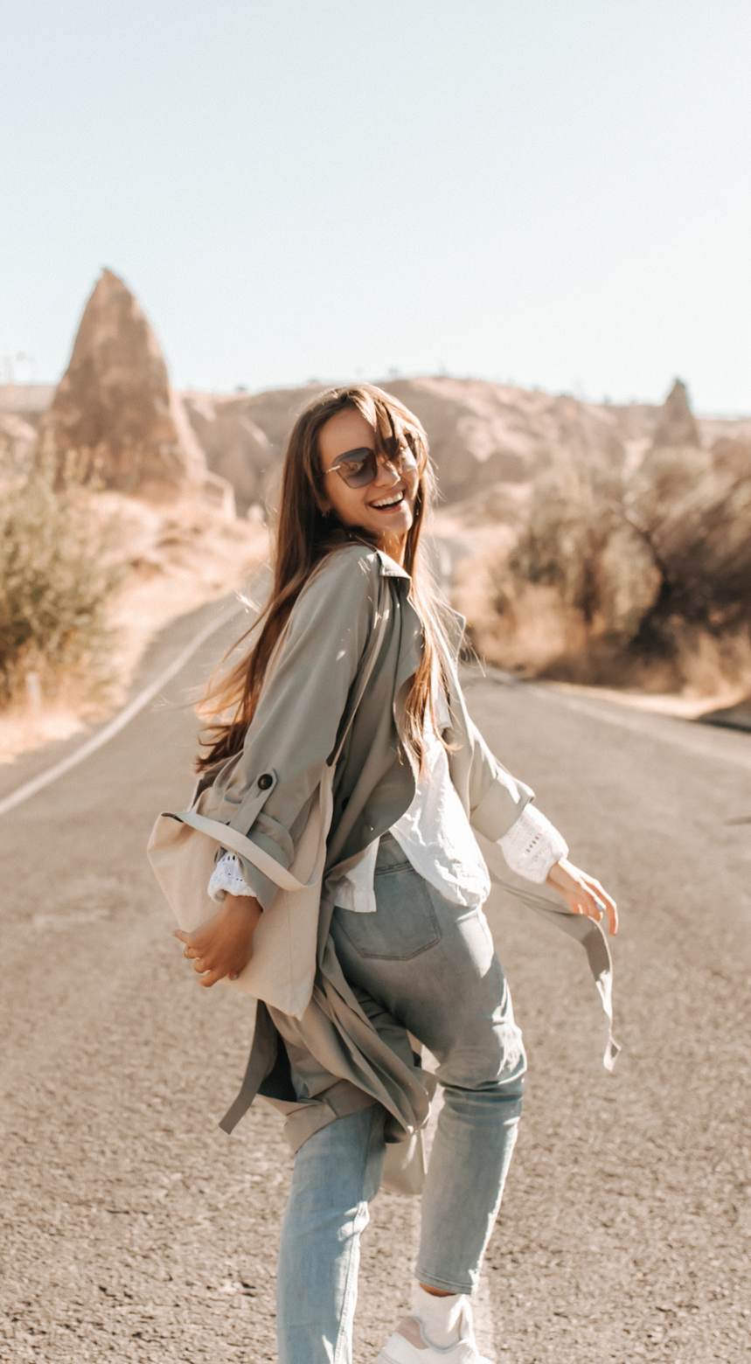
CONT …
(3 Local station on which we would air the ad?)
FM 101 Lhr
CityFM89 Khi
Power 99 Isb
FM 101 Lahore, a popular radio station, offers wide-reaching content, including music, talk shows, and entertainment segments, appealing to diverse demographics. Broadcasting our ad here ensures exposure to a large and engaged audience in Lahore, a key market for EverGreen clothing.
CityFM89 Karachi, a prominent radio station, caters to urban audiences with diverse content. With Karachi's significant youth population, advertising on CityFM89 effectively engages teenagers and youth aged 13-25, boosting EverGreen clothings' awareness in this key market.
Power99 Islamabad, a top radio station, serves the capital and surrounding areas with a strong urban youth and professional following. Advertising here effectively reaches teenagers and youth aged 13-25, young adults, and working professionals, maximizing EverGreen clothings' exposure and sales in Islamabad.

Slide 12
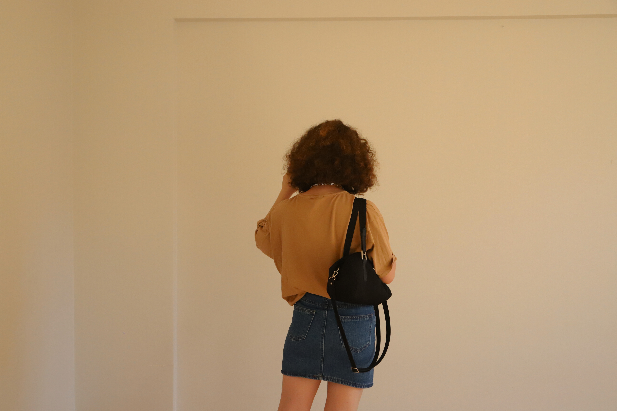




CONTACT US
123-456-7890
@evergreen
queries@evergreen.com
www.evergreen.com

Slide 13
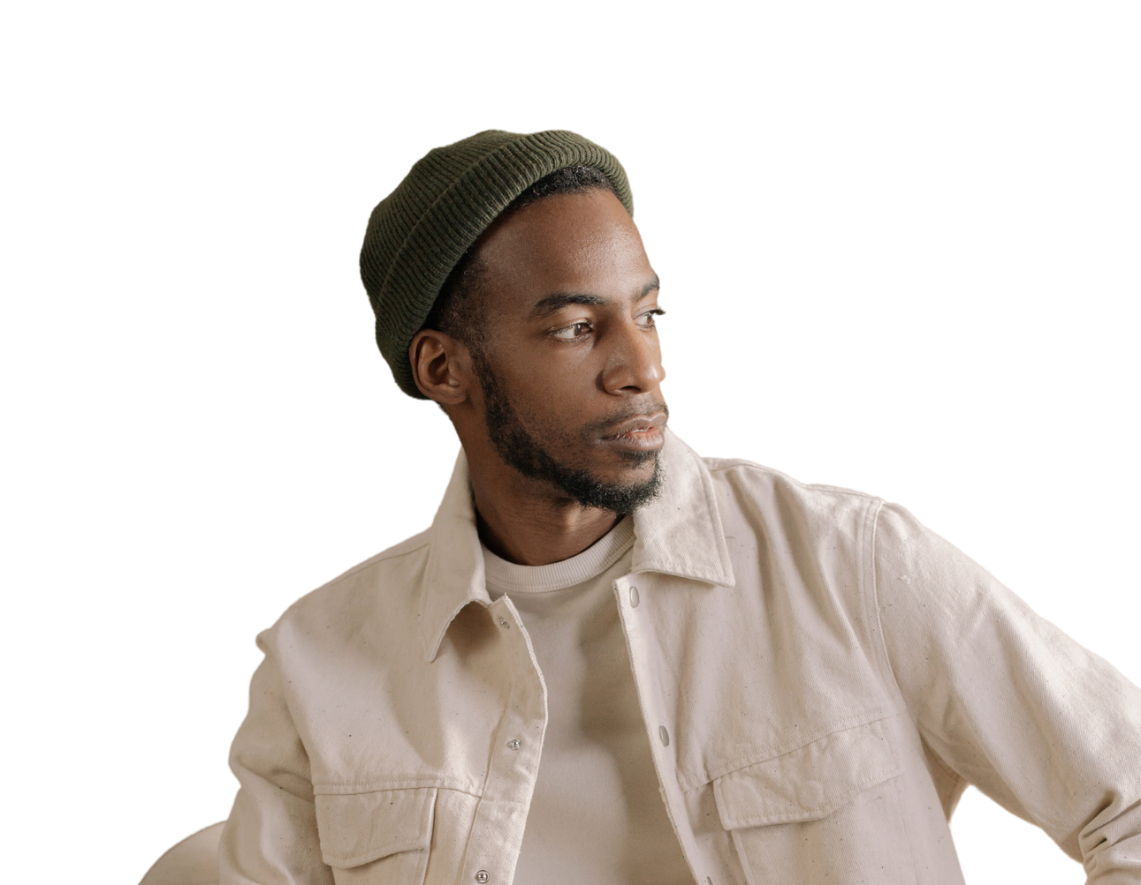
THANK YOU
The abundance of women's outfits featured in the slides does not signify an absence of options for men.

